Slide 1







CUSTOMER
SEGMENTATION
ANSHIKA BANSAL

Slide 2

Problem Statement
A SENIOR LIVING FACILITY AIMS TO ENHANCE ITS SERVICES AND OPTIMIZE RESIDENT SATISFACTION. THE FACILITY COLLECTS VARIOUS DATA POINTS RELATED TO ITS RESIDENTS, INCLUDING DEMOGRAPHICS, PREFERENCES, AND ACTIVITY ENGAGEMENT. THE OBJECTIVE IS TO SEGMENT THE RESIDENT POPULATION BASED ON THEIR CHARACTERISTICS AND BEHAVIORS AND ANALYZE EACH SEGMENT TO IDENTIFY OPPORTUNITIES FOR PERSONALIZED CARE AND SERVICE IMPROVEMENTS.

Slide 3
Approach
1
2
3
4
5
STEP
STEP
STEP
STEP
STEP
Data Collection and Preparation
Feature Engineering
Dimensionality Reduction
Segmentation Algorithm Selection and Model Development:
Cluster Profiling
Analyze each cluster's characteristics, preferences, and behaviors.
Utilize descriptive statistics, data visualization, and exploratory data analysis techniques to understand cluster patterns.
Identify key differentiating factors among the clusters, such as PAYOR, ROOMRATES, SERVICERATES, OCCUPANCYTYPE, UNITCLASS, etc..
Gather comprehensive resident data.
Cleanse and preprocess the data, handling missing values, outliers, and data inconsistencies.
Perform feature engineering techniques, such as data transformation, scaling, and encoding, to prepare the features for analysis
Dimensionality reduction with PCA.
Plotting the reduced dataframe.
Elbow Method to determine the number of clusters to be formed
Clustering via Kmeans Clustering
Examining the clusters formed via plots.

Slide 4
pandas: Data manipulation and analysis library, provides data structures and functions for handling structured data.
numpy: Numerical computing library, provides support for large, multi-dimensional arrays and matrices, along with a collection of mathematical functions.
matplotlib.pyplot: Plotting library, used for creating visualizations such as line plots, scatter plots, histograms, etc.
seaborn: Data visualization library, built on top of matplotlib, provides a high-level interface for creating aesthetically pleasing statistical graphics.
sklearn.preprocessing.LabelEncoder: Encoding categorical variables into numerical values.
scipy.stats: Module for statistical functions and distributions, provides various statistical measures and hypothesis tests.
Libraries and Modules
Function of the libraries and modules we have used in the process.

Slide 5
sklearn.preprocessing.StandardScaler: Standardizing numerical features by scaling them to have zero mean and unit variance.
sklearn.cluster.KMeans: K-means clustering algorithm, used for partitioning data into K distinct clusters.
sklearn.decomposition.PCA: Principal Component Analysis (PCA), a dimensionality reduction technique for transforming data into a lower-dimensional space.
yellowbrick.cluster.KElbowVisualizer: Visualizes the "elbow" point in the within-cluster sum of squares (WCSS) to determine the optimal number of clusters.
plotly.express: High-level interface for creating interactive visualizations, including scatter plots, bar plots, and more, using the Plotly library.
Libraries and Modules
Function of the libraries and modules we have used in the process.

Slide 6

Segmentation Methodology
ALGORITHM SELECTION AND WORKING
DIMENSIONALITY REDUCTION
In this problem, there are many factors on the basis of which the final classification will be done. These factors are basically attributes or features. The higher the number of features, the harder it is to work with it. This is why I will be performing dimensionality reduction on the selected features before putting them through a classifier. Principal component analysis (PCA) is a technique for reducing the dimensionality of such datasets, increasing interpretability but at the same time minimizing information loss. Steps in this section: Dimensionality reduction with PCA Plotting the reduced data-frame

Slide 7
Segmentation Methodology
ALGORITHM SELECTION AND WORKING
K-Means Clustering
Now that I have reduced the attributes to three dimensions, I will be performing clustering via K-Means clustering. Mention that K-means clustering aims to group similar data points together based on their features. The algorithm works by iteratively assigning each data point to the nearest centroid and updating the centroids based on the newly assigned data points. The distance between data points and centroids is typically measured using Euclidean distance. This process continues until convergence, where the assignments and centroids no longer change significantly. Steps involved in the Clustering Elbow Method to determine the number of clusters to be formed Assign the value for selecting the number of clusters. Examining the clusters formed via plots such as Scatterplot, Countplot, BarPlot, etc.

Slide 8

Solution for the Problem Statement.
We have divided the Dataframe into two main groups one for the customer(on the basis of RESIDENTID) and another for unit(on the basis of UNITNUMBER and FACITLITYID).
Columns used in Segmentation:- FACILITYID, UNITNUMBER, UNITCLASS, RESIDENTID, SHORTTERMSTAY, ONHOLD, ONHOLDREASON, ROOMBOARDRATE, SERVICELEVELRATE, MEDADMINRATE, ROOMBOARDMARKETRATE, SERVICELEVELMARKETRATE, MEDADMINMARKETRATE, OCCUPANCYTYPE, UNITCOMBINED. Cluster, PAYOR.
Applied PCA on the unit dataframe, and reduced it to 3 columns (PC1, PC2, PC3).
Chose k=3 clusters using the K-means algorithm.
3 Clusters are formed in total.

Slide 9
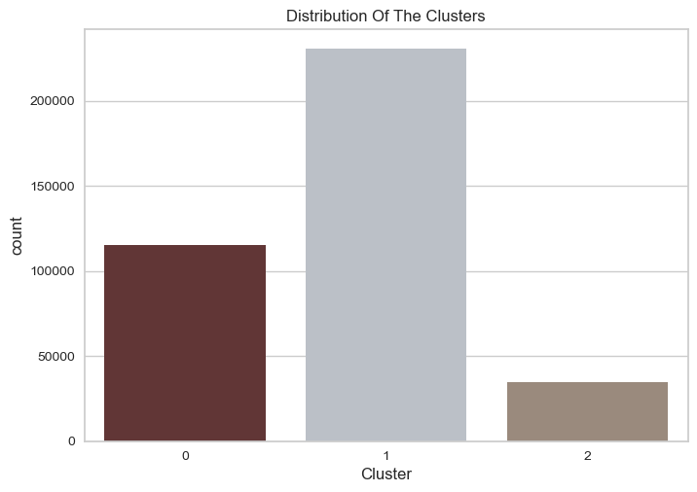
Insights
CLUSTER 0
Contains values(resident id) more than 100000+
Having a Maximum percentage of UNITCLASS 'Studio (0)'
Contains the count of maximum RESIDENTID with shorttermstay
Most Profitable Cluster.

Slide 10
Insights
CLUSTER 1
Biggest Cluster with more than 200000+ values.
Maximum percentage of UNITCLASS 'Single BedRoom (1)
Maximum RESDIENTID with PAYOR type = 'PRIVATE', 'MEDICAID'
Containing highest percentage of OCCUPANCYTYPE('SEMIPRIAVTE','COUPLE')

Slide 11
Insights
CLUSTER 2
The smallest cluster among all with values greater than 50k
Contains the minimum number of units.
The lowest percentage of short-term stays.
Least Occupancy Type
Contains the maximum number of facility IDs

Slide 12




Conclusion
Cluster 0 - Most Profitable Segment:
This cluster represents the most profitable group of residents, with over 100,000+ residents.
The majority of residents in this cluster prefer 'Studio (0)' unit types, which could indicate a preference for smaller, more affordable units.
Short-term stays are popular among residents in this cluster, contributing to higher turnover and potentially increased revenue.
Cluster 1 - Largest and Diverse Segment:
Cluster 1 is the largest cluster, comprising over 200,000 residents, making it a significant market segment.
Residents in this cluster prefer 'Single BedRoom (1)' unit types, indicating a preference for larger living spaces.
The majority of residents in this cluster have 'PRIVATE' or 'MEDICAID' payor types, which may suggest diverse financial backgrounds.
Occupancy types like 'SEMIPRIVATE' and 'COUPLE' are prevalent in this cluster, indicating a mix of individual and couple residents.

Slide 13
Conclusion
Cluster 2 - Niche Segment with Unique Characteristics:
Cluster 2 is the smallest among all clusters, with over 50,000 residents, making it a niche market segment.
Residents in this cluster show a preference for the minimum number of units, possibly indicating a niche demand for specific types of units.
Short-term stays are less common in this cluster, suggesting a preference for longer-term living arrangements.
Occupancy types in this cluster are different from other clusters, indicating a unique lifestyle or care requirements.
The maximum number of facility IDs in this cluster suggests a dispersion of facilities catering to specific needs.
Overall, the segmentation analysis highlights distinct customer segments with unique preferences and characteristics. Leveraging these insights, senior living facilities can tailor their offerings, marketing strategies, and services to meet the specific needs of each cluster. This targeted approach can lead to enhanced resident satisfaction, improved resource allocation, and ultimately, higher profitability and success in the senior living market.

Slide 14

In case you have any queries or suggestions, feel free to reach out!!
anshikabansal917@gmail.com

